Slide 1
Ford’s Bogus Climate Plan
David Robertson, scan!
For Environment Haliburton
February 8, 2022
Notes:
Slide 1: title slide
Slide 1: title slide
Thanks Terry. To EH for inviting me and to all of you for taking the time to participate

Slide 2
The Scientific evidence and an urgent call to action
Intergovernmental panel on Climate Change (IPCC) Sixth Assessment Report
Climate Change 2021: The Physical Science Basis
Notes:
Slide 2: The Scientific evidence and an urgent call to action
In the months leading up to COP 26 there was a series of reports that detailed the severity of the climate emergency and the urgency of our situation.
Intergovernmental panel on Climate Change (IPCC) Sixth Assessment Report
Climate Change 2021: The Physical Science Basis

Slide 3
The IEA report shocked industry and rattled governments
International Energy Agency (IEA)
Global Energy Review 2021 April 2021
Net Zero by 2050 May 2021
World Energy Outlook Oct 2021
Notes:
Slide 3: The IEA report shocked industry and rattled governments

Slide 4
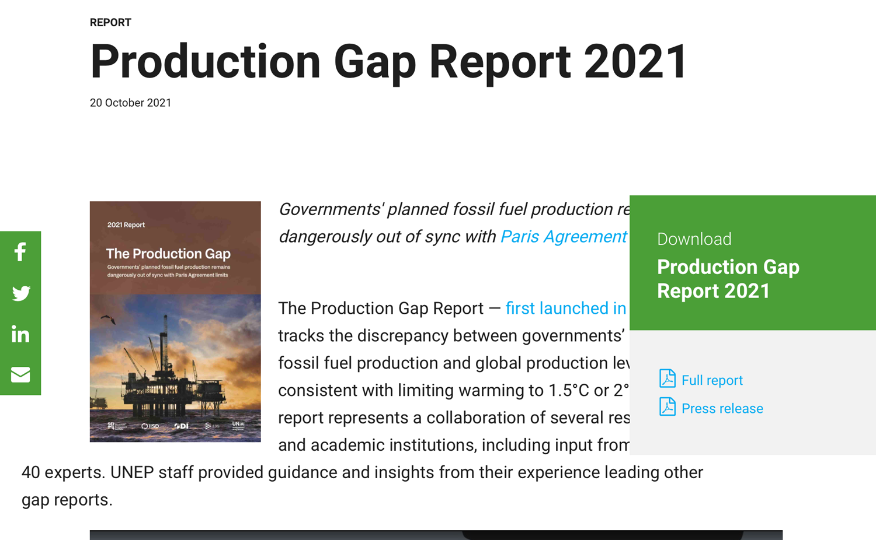
The reports and the evidence are piling up
The United Nations
UN Initial NDC Synthesis Report Feb 2021
UN NDC Synthesis Report Sept 2021
UN 2021 Production Gap Report
Notes:
Slide 4: The Scientific evidence and an urgent call to action
The United Nations
UN Initial NDC Synthesis Report Feb 2021
UN NDC Synthesis Report Sept 2021
UN 2021 Production Gap Report

Slide 5
The conclusions
Stop fossil fuel expansion
Rapidly phase out the production and burning of fossil fuels
Invest heavily in renewable energy
Notes:
Slide 5: The Conclusions
The reports were comprehensive.
They were alarming.
And they were absolutely clear on what has to be done.
Our governments have to
Stop fossil fuel expansion
Rapidly phase out the production and burning of fossil fuels
Invest heavily in renewable energy

Slide 6
The situation is frightening and the language conveys it
The climate crisis is leading to an “unimaginable and unforgiving” world.
Notes:
Slide 6: the situationis frighteneingTh The situation is frightening and the language conveys itThe climate crisis is leading to an “unimaginable and unforgiving” world. e situation is frightening and the language conveys it

Slide 7
Code red world; the UN General Secretary, Antonio Guterres
“code red for humanity. The alarm bells are deafening, and the evidence is irrefutable.”
Notes:
Slide 7: Code red world
Perhaps the most famous quote of 2021 (other than Greta’s) was delivered by the UN general secretary when he concluded that
“code red for humanity. The alarm bells are deafening, and the evidence is irrefutable.”

Slide 8
The evidence of our own experience
Notes:
Slide 8: evidence of our own experience
The evidence in the repors was reinforced by the evidence of our own experience.
In Ontario tornadoes and forest fires that raged out of control and blanketed communities hundreds of miles away in smoke.

Slide 9
New climate terms have entered our vocabularies
Heat domes and atmospheric rivers, climate anxiety.
Climate records are routinely broken by more and more violent fires, floods, heatwaves and droughts.
2021 ---extremes the new normal.
Notes:
Slide 9: new climate terms
New New climate terms have entered our vocabularies
Heat domes and atmospheric rivers.
Climate records are routinely broken by more and more violent fires, floods, heatwaves and droughts.
2021 ---extremes the new normal.

Slide 10
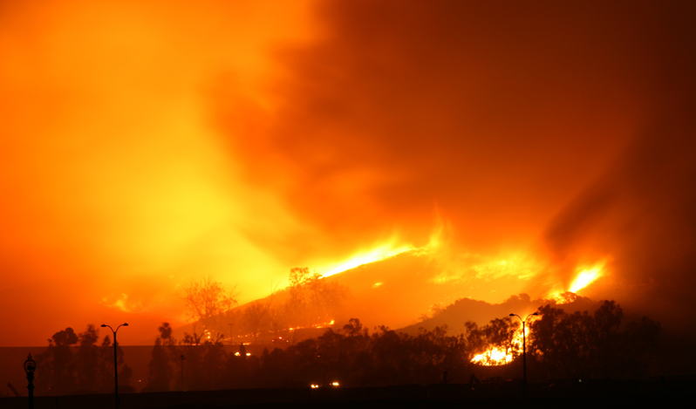
Lytton, BC
Notes:
Slide 10: Lytton BC
We watched in desperation at the death and destruction it Lytton BC and then

Slide 11
Floods and droughts and deaths
Notes:
Slide 11: Floods and Droughts
With the floods and the droughts and the deaths.

Slide 12
COP 26 and the Glasgow Climate Pact
For all its failings the Pact is a desperate plea.
“expresses alarm and utmost concern” that countries are not doing enough.
It “stresses the urgency of enhancing ambition”.
It “emphasizes the urgency of scaling up action and support”.
The language is meant to galvanize action.
Notes:
Slide 12: COP 26
In November of 2021 countries from around the world convened in Glagow at COP 26 in an effort to avert or at least forestall the cclimate catastrophe. For all its failings the Pact is a desperate plea. Throughout its few pages it “expresses alarm and utmost concern” that countries are not doing enough. It “stresses the urgency of enhancing ambition”. It “emphasizes the urgency of scaling up action and support”. The language is meant to galvanize action.
But while negotiators from countries all around the world were trying to forge a climate consensus in Glasgow, Ford was back home in Ontario adding fuel to the fire.

Slide 13
While the world was at COP 26, the Ontario government was back home preparing its November Economic Outlook
The economic outlook is 198 pages.
The words ‘climate emergency’ never appear.
The words ‘climate crisis’ not to be seen.
The words ‘climate change’ appear twice in the same, single paragraph.
Notes:
Slide 13: while the World
While the world was at COP 26, the Ontario government was back home preparing its November Economic Outlook
The economic outlook is 198 pages.
The words ‘climate emergency’ never appear.
The words ‘climate crisis’ not to be seen.
The words ‘climate change’ appear twice in the same, single paragraph.

Slide 14
And where the words appear--- turbocharged greenwashing
“… the government is growing the Greenbelt to help build resilience to and mitigate climate change.
The word growth appears 193 times
Notes:
Slide 14: and where the words appear“
In addition, the government is growing the Greenbelt to help build resilience to and mitigate climate change,…
(P 41)
The word growth appears 193 times
Getting ahead of myself.

Slide 15
outline: four parts
Ontario primer
energy sources, use and emissions
Ford’s climate plan
Mitigation: Eight prong program
Adaptation
Ford’s climate crimes
Economic framing
Highlight a few
Developing a new Ontario Climate Plan
Notes:
Slide 15: Outline
In the time I will try to accomplish four things. I will start with a bit of a primer
Ontario primer
energy sources, use and emissions
Ford’s climate plan
Mitigation: Eight prong program
Adaptation
Ford’s climate crimes
Economic framing
Highlight a few
Developing a new Ontario Climate Plan

Slide 16
Part 1: Setting the stage
Some quick facts, figures and trends
Notes:
Slide 16: Setting the stage
I'm going to set the stage with some quick facts and trends

Slide 17
GHG Emissions in Canada
Ontario in second place
worst
38%
22%
Notes:
Slide 17: GHG Emissions in Canada
Two provinces in Canada are responsible for 60% of Canada’s ghg emissions.
As you can see from the map Ontario is in second place., the second worst.
Since Ont accounts for so much of the country’s emissions what we do in Ontario has an outsized effect on Canada’s ability to achieve its Paris commitments.

Slide 18
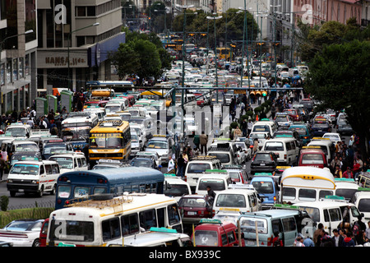
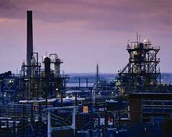
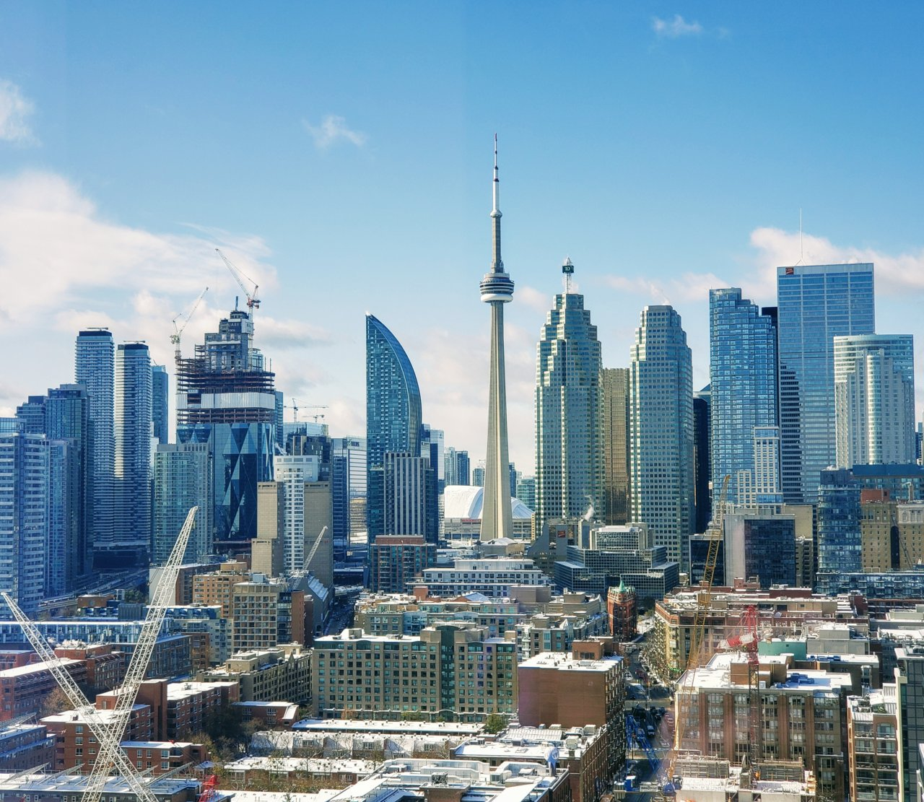
Sector Emissions
Transportation 35%
Industry 30%
Buildings 22%
The third largest source of emissions is from buildings. Buildings produce about 22% of GHG emissions.
At 35% transportation is the largest source of GHG in Ontario
Industry is in second place with 30% of GHG emissions
Notes:
Slide 18: :Sector Emissions
On a sector by sector basis here’s what we know
Emissions from the transport sector, contributed 35% of the provinces total emissions. (transport sector Canada wide is 2
The second largest source of emissions is from industry at 30%.
The third largest source is from buildings. Buildings produce about 22% of GHG emissions
Taken together those three sectors account for 87% of cdas emissions
The corollary is this. To have any chance of keeping temperatures below climate tipping points requires dramatic reductions from those three sectors

Slide 19
Behind each of these sectors’ emissions is the burning of fossil fuels
Cars and trucks run on gasoline
Natural gas is the main source of heating in Ontario residences
Industry runs, in large part, on fossil fuels
Notes:
Slide 19: Behind each of these sectors emissions is the burning of fossil fuels
In turn that means we have to stop burning fossil fuels in those sectors because
Cars and trucks run on gasoline. The main source of heat in residential buildings is natural gas
And industry runs, in large part on fossil fuels.

Slide 20
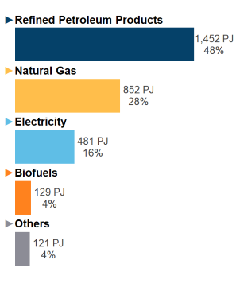
Most of the energy used in Ontario IS derived from FOSSIL FUELS (data from CER and IESO)
Over 75% from fossil fuels
Notes:
Slide 20: Most of the energy used in Ontario IS FOSSIL FUELS
We know that most of the energy used in Ontario is derived from oil and gas.
As this slide shows over three quarters of our energy is oil and gas.
And actually the situation is a bit worse

Slide 21
Most of the energy used in Ontario IS FOSSIL FUELS (data from CER and IESO)
Electricity 16%
Nuclear
Hydro
Wind
Solar
Biomass
Gas Gas Gas Gas
Notes:
Slide 21: Most of the energy used in Ontario IS FOSSIL FUELS
Electricity accounts for only 16% of our energy use. But electricity isn’t all clean or green. While the share of gas in our electricity supply is relatively low. It is slated to grow significantly.

Slide 22
Gas is the new Coal
In May of 2020 provincially owned Ontario Power Generation spent $2.8 billion to buy three natural gas plants.
Notes:
Slide 22: Gas is the new Coal
Ontario achieved a major shift when coal powered gas plants were eliminated. But now Ford is making another seismic shift to gas fired electricity.
Ontario has 12 gas fired powered stations.
In May of 2020 provincially owned Ontario Power Generation spent $2.8 billion to buy three natural gas plants.
As nuclear plants are refurbished and offline the government plans to expand the share of electricity produced from fossil fuels. The OCAA has estimated gas could provide 20% of electricity production by 2030. Gas is the new coal.

Slide 23
Electricity is supposed to reduce GHG emissions. In Ontario gas fired electricity will increase emissions
Notes:
Slide 12: Electricity is supposed to reduce GHG emissions. In Ontario gas fired electricity will increase emissions
It will also mean that ghg emissions from Ontario's electricity sector will increase. Again, this chart is from the IESO and the yellow line is the tell tale.

Slide 24
Canada’s Big Emitters:
1700 GHG polluters responsible for 40% of all GHG emissions
Notes:
Slide 24: Canada’s Big emitters:
Earlier I said that the second largest sources of Ontario’s emissions come from industry. We know that 1700 Big emitters are responsible for 40% of all GHG pollution in the country. And we know who they are and where they are. Although hard to see individual sites the map does suggest the concentrations. Again Ontario figures prominently.

Slide 25
We know who and where the Big Emitters are
Ontario has 347 of the country’s largest emitters
Ontario has large emitters in heavy industry, like cement and steelmaking,
Regional concentrations such as the Sarnia area which is home to many of Ontario’s largest emitters and includes oil refineries, chemical manufacturing, and a natural gas plant.
Notes:
Slide 25: We know who and where the Big Emitters are
Ontario has 347 of the country’s largest emitters
The Auditor General has provided a list of the top 25
Ontario has large emitters in heavy industry, like cement and steelmaking,
Regional concentrations such as the Sarnia area which is home to many of Ontario’s largest emitters and includes oil refineries, chemical manufacturing, and a natural gas plant.

Slide 26
Part 2: Ford’s Climate Plan
Where can you find it and what does it say?
Notes:
Slide 26 : Ford’s Climate Plan

Slide 27
Ford’s climate plan announced in 2019
The Ford government climate plan is a section of:
“Preserving and Protecting our Environment for Future Generations: A Made in Ontario Environmental Plan”
Notes:
Slide 27: Ford’s climate plan announced in 2019
Ford’s climate plan was announced in 2019 and was buried as section in the overall environment plan.

Slide 28
Trashed the Previous government’s climate plan
Removed the words ‘climate change’ from the name of the Environment ministry
Scrapped the cap and trade program
Tore up 750 green energy contracts
Launched a court challenge to the federal carbon pricing system
Eliminated the position of the Environment Commissioner
Scrapped the subsidies for zero emission vehicles
Cancelled the tree planting program
Removed electric chargers from GO stations
Reduced emission targets and eliminated legislated requirements
Notes:
Slide 28 :Trashed the Previous government’s climate plan
Before he announced the ‘Made in Ontario” plan Ford first trashed the climate programs that were in place.
His actions ranged from
The spiteful. He removed the words ‘climate change’ from the environment ministry
The petty--- he ripped out the charging stations from GO stations.
The vengeful –he scrapped the cap-and-trade program
The wasteful -$230 million to tear up green energy contracts,
The ludicrous- scrapped the tree planting program
The alarming –he reduced Ontario’s emission targets.

Slide 29
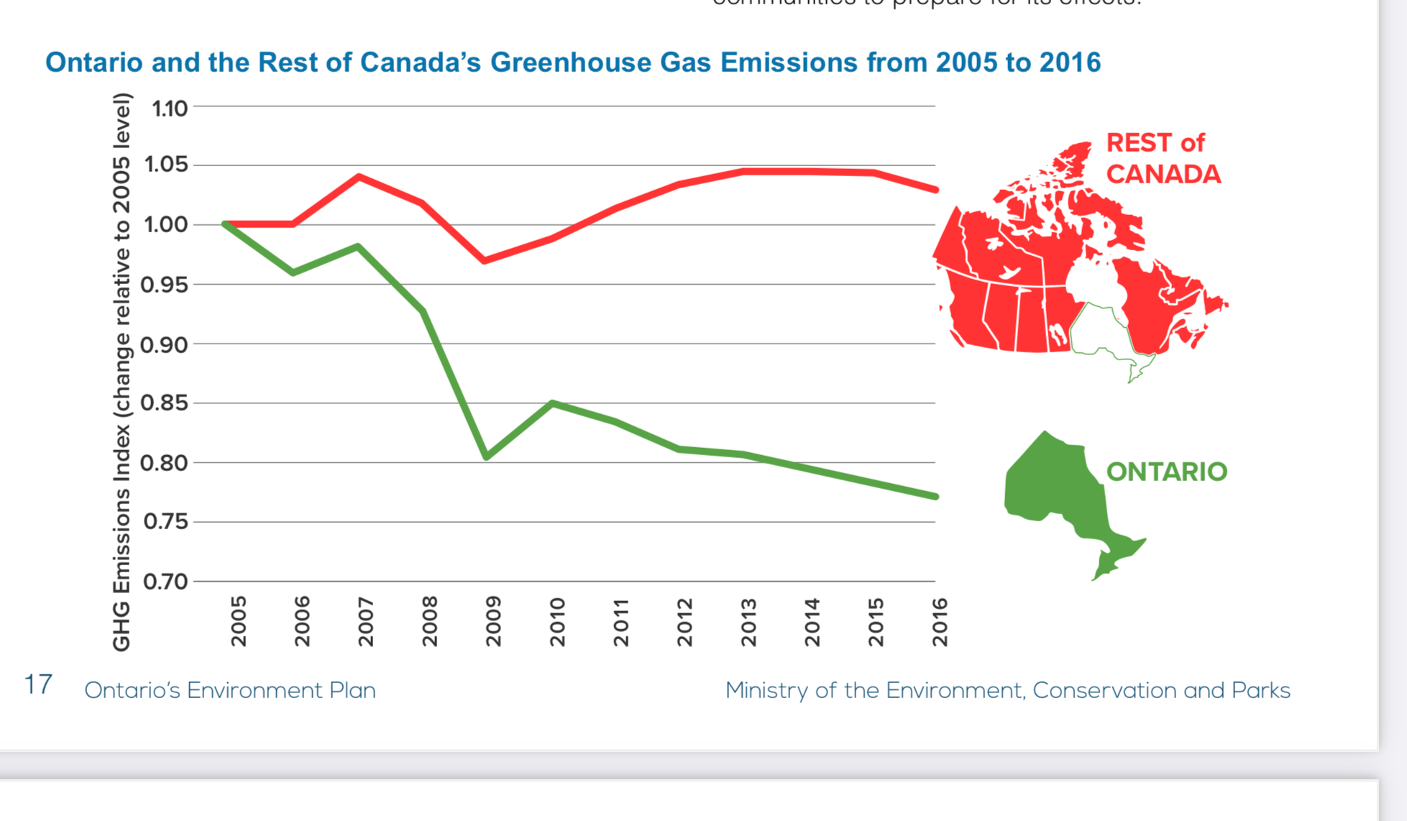
From “Made in Ontario” plan
By the time the govt wrote that it was already past tense…
Notes:
Slide 29: From Made in Ontario plan
He trashed the programs and then took credit for their results. This is a quote from the Ford plan.
Quick Fact: almost all of Canada’s progress towards its 2030 Paris Agreement targets has been driven by Ontario.
And to reinforce the point they provide the graph on the right.
Two points. The graph ends in 2016 and by the time the government wrote its’ quick fac’t it was already playing loose with the evidence.

Slide 30
Historical GHG emission trends in Ontario
Notes:
Slide 30 :Historical GHG emission trends
Until the election of Doug Ford Ontario was making good progress on reducing GHG emissions. You can see the trend downward, much of it a result of shutting down Ontatio’s coal fired eledctricity plants.

Slide 31
Historical trend in GHG Emissions
Canada.ca/ghg-inventory National Inventory Report – 2021 Edition Part 3
Year | kt CO2 eq GHG
1990 | 180,000
2005 | 206,000
2014 | 164,000
2015 | 163,000
2016 | 161,000
2017 | 158,000
2018 | 163,000
2019 | 163,000
Ford gets elected
Notes:
Slide 31: Historical trend in GHG Emissions
Ford was elected in 2018. there is only data for his first couple of years. Instead of consolidating the gains that had been made he did an about face on climate action and He has bent the emission curve upwards.

Slide 32
Ford’s “made in Ontario” plan
Reduce Ontario GHG emissions by 30% by 2030 over 2005
Notes:
Slide 32: Ford’s “made in Ontario” plan
Ford introduced a revised climate target to reduce Ontario GHG emissions by 30% by 2030.

Slide 33
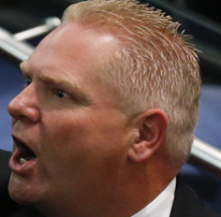
Ford’s dilemma: a climate plan without climate action
Already decided
That green, renewable energy was not part of the equation
To fight the federal carbon pricing system in the courts and through an expensive PR campaign
To cut subsidies for initiatives such as zero emission vehicles
Notes:
Slide 33: Ford dilemma was how to have a climate plan without climate action
Ford’s dilemma was how to have a climate plan without climate action. He had already boxed himself in. He had already decided
That green, renewable energy was not part of the equation
To fight the federal carbon pricing system in the courts and through an expensive PR campaign
To cut subsidies for initiatives such as zero emission vehicles

Slide 34
Ford’s plan: eight prong ‘Non-action’ program
Low carbon vehicles
Emission performance standards
Clean Fuels
Federal clean fuel standard
Natural gas conservation
Emission reduction fund
Other policies
Innovation
Notes:
Slide 34 Ford’s plan: eight prong Non-action program
What he was left with was a mashup of this and that and a whole lot of wishful thinking and deceitful accounting. He called it an eight-prong program.
That short list is the entirety of the Ford climate plan.

Slide 35
Ford’s plan to reduce emissions by 30% by 2030 over 2005
Business as usual
At 30% reduction
Notes:
Slide 35: Ford’s plan to reduce emissions by 30% by 2030 over 2005

Slide 36
Other policies
Natural gas conservation
Low carbon vehicles
Notes:
Slide 36: Ford plan to reduce emissions by 17.6 MT
According to the plan a 30% target, means reducing emissions by 17.6 MT---a totally inadequate number. The govt has estimated the emission reduction potential from each of the eight prongs.

Slide 37
Example 1: Low carbon Vehicles
Almost 15% of emission reductions to come from the shift to electric vehicles.
2.6 MT reduction
By 2030 there would be 1.3 million electric cars.
More than a 3000% increase over the number in 2019.
Notes:
Slide 37: Example 1: Low carbon Vehicles
Almost 15% of the emission reductions to come from the Ford government has projected for 2030 results from the shift to electric vehicles.
To arrive at this number the government estimated that by 2030 there would be 1.3 million electric cars on the road in Ontario.
The figure represents more than a 3000% increase over the number of electric cars on the road in 2019.

Slide 38
Oops! we miscalculated
The government included the projected surge in electric vehicle sales that were anticipated on the basis of the subsidy program that Ford had already cancelled.
Ford cancelled the program then calculated emission reductions as if the program was still in place.
Notes:
Slide 38: Oops! we miscalculated
In arriving at that number the government included the projected surge in electric vehicle sales that were anticipated on the basis of the subsidy program that Ford had already cancelled.
Ford cancelled the program then calculated emission reductions as if the program was still in place.
Caught out by the Auditor general the government has admitted that instead of the projected 2.6 MT emission reduction in the Plan, electric vehicles will only account for 0.9 Mt reduction.

Slide 39
downward revision and again
The government has admitted that instead of the projected 2.6 MT emission reduction in the Plan, electric vehicles would only account for 0.9 Mt reduction.
In a November 2021, report the Auditor General noted that the government had revised its projected emission reductions from electric vehicles beyond the ‘business as usual’ case down to zero.
2.6 MT
0.9 MT
0.0 MT
Notes:
Slide 39: downward revision and again
The government has admitted that instead of the projected 2.6 MT emission reduction in the Plan, electric vehicles would only account for 0.9 Mt reduction.
In a November 2021, report the Auditor General noted that the government had revised its projected emission reductions from electric vehicles beyond the ‘business as usual’ case down to zero.

Slide 40
Example 2: Emission Performance Standards
Emission Performance Standards--some of the biggest reductions in carbon emissions.
Industry standards--- threshold beyond which polluters would have to pay for additional carbon emissions.
Estimate--over 15% of the overall emission reductions by 2030.
Notes:
Slide 40: Example 2: Emission Performance Standards
One of the biggest reduction in carbon emissions, according to the Ford plan, is to be achieved by the introduction of Emission Performance Standards.
These are facility and sector specific standards that, once set would be threshold beyond which industry would have to pay for additional carbon emissions.
In the original plan these standards were estimated to account for over 15% of the overall emission reductions by 2030.

Slide 41
their impact has been drastically down graded
When introduced these standards were expected to achieve a reduction of 2.7 Mt.
The government, has now admitted they will only account, at best, for a 1 Mt GHG reduction.
Industry is responsible for 30% of Ontario’s GHG emissions.
That amounts to 49 MT
The EPS will only eliminate 1 MT or 2%.
Notes:
Slide 41:their impact has been drastically down graded
When introduced these standards were expected to achieve a reduction of 2.7 Mt.
The government, has now admitted they will only account, at best, for a 1 Mt GHG reduction.
Industry is responsible for 30% of Ontario’s GHG emissions.
That amounts to 49 MT
The EPS will only eliminate 1 MT or 2%.

Slide 42
All eight prongs of the ‘Made in Ontario’ climate plan are overstated
The natural gas conservation program was exaggerated,
The clean fuel initiative was overstated,
The hydrogen initiative was overestimated,
The organic waste initiative was inflated
and on an on.
Notes:
Slide 42: All eight prongs of the ‘Made in Ontario’ climate plan are overstated
And these aren’t the only examples. The natural gas conservation program was exaggerated, the clean fuel initiative was overstated, the hydrogen initiative was overestimated, the organic waste initiative was inflated and on an on.

Slide 43
Auditor General
The AG report of 2019 concludes that the Ford government claims were ‘not supported by sound evidence”.
In November 2021, the Auditor General noted once again:
“We found that the Ministry’s projected emissions forecast, and the estimated emissions reductions for all eight areas, were not yet supported by sound evidence.”
Notes:
Slide 43: Auditor General
The AG report of 2019 concludes that the Ford government claims were not “supported by sound evidence”.
In November 2021, the Auditor General noted once again:
“We found that the Ministry’s projected emissions forecast, and the estimated emissions reductions for all eight areas, were not yet supported by sound evidence.”

Slide 44
The government has ‘committed policies’ in place to eliminate only 3.4 MT of emissions.
2021, Ontario Auditor General
Other policies
Natural gas conservation
3.4
Low carbon vehicles
Notes:
Slide 44: Ontario Auditor says the plan is not supported by evidence
Basically, she concluded that none of it was true. And instead of eliminated 17.6 MT of GHG there were committed policies in place to eliminate only 3.4 MT
that is the little yellow box on the slide.

Slide 45
A bigger problem
The evidence in the Auditor’s reports is clear: The Ford government will not reach its 2030 targets.
There is a huge gap between the Ford plan and what actually needs to get done.
Ford’s 30% reduction target is out of date and out of step with what is needed
Notes:
Slide 45: A bigger problem
The evidence in the Auditor’s report makes it clear: On the basis of current plans, the Ford government will not reach its 2030 targets.
The bigger problem is the huge gap between what Ford is doing and what actually needs to get done.
Ford’s 30% reduction target is out of date and out of step with what is needed

Slide 46
Scoping the size of the problem
Even to match the federal governments higher target of 45% reduction means a huge increase in climate ambition.
2005 emissions = 205.7 MT
2030 emissions at 45% reduction = 113.1 MT
Ford election 2018 emissions =163 MT
Difference 163-113 = 50 MT
Ford has ‘committed policies’ to reduce 3.4 MT when we need to reduce GHG emissions by, at the very least, 50MT.
Notes:
Slide 46: Scoping the size of the problem
If Ford was to match the federal emission reduction target, he would have to achieve a 40-45% reduction.
At 45% -a target that is still too low—the required reduction is 50MT not 17.6 MT
Ford has ‘committed policies’ to reduce emissions by 3.4 MT when we need to reduce them by 50MT, at the very least.
That news is really worrying.

Slide 47
2030 Emission reduction targets and Ford’s plan
45%
17.6 MT
50 MT
3.4 MT
Notes:
Slide 47: Emission reduction targets and Ford’s plan

Slide 48
Mitigation scorecard
An inadequate, out of date emission reduction target
A plan in complete tatters
Emissions are going in the wrong direction
Not serious about any climate targets
Notes:
Slide 48: Mitigation scorecard
An inadequate, out of date emission reduction target
Emissions are going in the wrong direction
Not serious about any climate targets

Slide 49
A climate plan requires both mitigation and adaptation
Mitigation
Adaptation
Reduce Greenhouse gas emissions
Reduce risk and increase resilience
Reducing and preventing losses from severe weather events
Notes:
Slide 49: A climate plan requires both mitigation and adaptation
Mitigation: Reducing Greenhouse gas emissions
Adaptation:
Reducing and preventing losses from severe weather events
Reduce risk and increase resilience

Slide 50
The climate crisis is here
We are already dealing with destructive weather events and that is at 1.3 degree Celsius
Severe weather damage to homes, businesses and public infrastructure
Need to limit or prevent losses from floods and fires and droughts and storms and heat waves and….
Notes:
Slide 50: The climate crisis is here
We are already dealing with destructive weather events and that is at 1.3 degree Celsius
Severe weather damage to homes , businesses and public infrastructure
Need to limit or prevent losses from floods and fires and droughts and storms and heat waves and….

Slide 51
Ontario’s Adaptation Plan
Notes:
Slide 51: Ontario’s Adaptation Plan
If the Premier really wanted to help out he would announce a climate adaptation plan

Slide 52
When the Ford government says anything about adaptation
It is vague, confused and without the required financial commitments
Notes:
Slide 52: When the Ford government says anything about adaptation
It is vague, confused and without the required financial commitments
Green Bond Program only 3% of funds for adaptation and resilience = 1 project

Slide 53
Ontario’s Climate Advisory Panel
Set up in 2019 as part of the ‘Made in Ontario’ climate plan
“The development and implementation of climate change resilience commitments”
The final report was supposedly submitted last November
The Standing Committee on Public Accounts recommended the government make the advice publicly available.
Notes:
Slide 53: Ontario’s Climate Advisory Panel
Set up in 2019 as part of the ‘Made in Ontario’ climate plan
“The development and implementation of climate change resilience commitments”
The final report was supposedly submitted last November
The Standing Committee on Public Accounts recommended the government make the advice publicly available.
??????

Slide 54
Part 3: A legacy of climate crimes
Ford is a climate denier
Notes:
Slide 54: Part 3: A legacy of climate crimes
We have seen that Ford’s climate plan is a cruel joke. It is not intended to do anything about the climate emergency because Ford has no interest in doing so. What is at issue is not only the inadequacy of the climate plan. but the fact that Ford’s policies and programs, legislation and actions are deepening climate crisis. And that brings us to part 3.

Slide 55
The economic framing of the climate plan
Captured in three quotes
Notes:
Slide 55: The economic framing of the climate plan
To understand Ford’s total disregard of the climate emergency it helps to focus a bit on the economic model behind his plan. Here is the economic framing of the climate plan expressed in three quotes

Slide 56
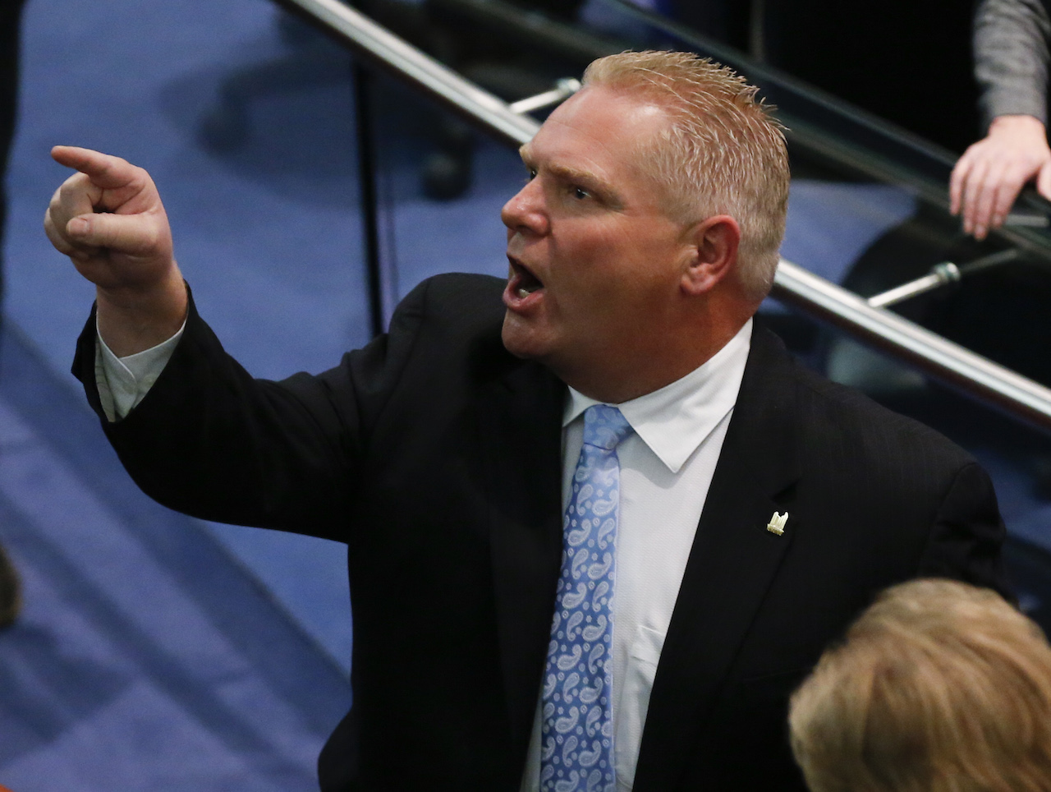
The first: “Terrible, terrible wind turbines.”
“If we had the chance to get rid of all the windmills we would”
Notes:
slide 56: The first: “Terrible, terrible wind turbines.”
the first quote is from the Premier. If we had the chance to get rid of all the windmills we would. Terrible terrible wind turbines.

Slide 57
The second: Doug Ford’s third environment minister
“This idea that the government can regulate and legislate its way to net zero or to combat climate change is an absolute fallacy,”
Notes:
Slide 57: The second
the second quote is from Ford’s third environment Minister. This idea that the government can regulate and legislate its way to net zero or to combat climate change is an absolute fallacy,”

Slide 58
The Third: Ontario Finance Minister: Nov 2021 finance statement
“We are ready to build bigger. We are ready to build faster than ever before”
Notes:
Slide 58: The Third
For the third quote we go to the Finance minister in his November 2021 Finance statement.
We are ready to build bigger. We are ready to build faster than ever before.

Slide 59
the trinity of influences behind the Ford climate plan
Ford’s support of fossil fuels
Economic model based on growth
Pro business Ideology
Notes:
Slide 59: the trinity of influences behind the Ford climate plan
The triad of influences behind the Ford climate plan are fords personal hatred of renewable energy which in turn translates to his full support of fossil fuels. Second a pro business ideology that maintains the fiction that the market solves everything and the role of government is to incentivize business, cut public spending and otherwise get out of the way of investors. And finally there is a commitment to unsustainable Growth.

Slide 60
Economic background to the climate plan
Fossil First
Growth First
Business First
Notes:
Slide 60: Economic background to the climate plan
This is the model
Fossil first
growth first
business first

Slide 61
Fossil First
Growth First
Business First
Gas fired electrical plants
Gas line expansion
Killing renewable power
Support of Line 5
Cut red tape and regulations
Cut electricity costs to big companies
MZO’s
Enbridge expansion subsidies
“Modernize public service”
SMR’s
Highways
Ripping up forests
“Unlocking critical minerals in the north”
Paving over wetlands
Urban sprawl
Notes:
Slide 61: no title
Providing Enbridge, a huge fossil fuel company, taxpayer subsidies to extend its natural gas infrastructure will add GHG emissions from the building sector,
Expanding gas fired electricity plants will increase GHG emissions
Building Hwy 413 will add GHG emissions from the transportation sector,
Doubling the allowable cut in boreal forests will carbon sink into a bigger carbon bomb.
Promoting mega resource extraction projects such as the Ring of Fire, will cause permanent damage to carbon sinks such as the peat bogs and cause the release of even more GHG emissions.
Using MZOs to run roughshod over environmental regulations so the government’s developer donors can pave over wetlands and build more urban sprawl will increase GHG emissions,
Adding expensive and experimental modular nuclear reactors to the Ontario’s electrical grid will increase hydro bills and further inhibit families from switching from fossil fuels heating systems to electrical ones.
Refusing to provide subsidies for zero emission vehicles and refusing to build up a reliable electric charging infrastructure will keep Ontario drivers burning fossil fuels longer than necessary.
Giving Big Emitters a free ride, as the government’s plan currently does, only adds fuel to an overheating planet.
With more time we could explore the consequences of this. For now let me point to the lists on the screen and to note that almost all of them are amongst the Ford climate crimes that the Ontario Project has drafted and which you have. And many of them have implications for Indigenous rights and sovereignty.

Slide 62
Fossil First
Growth First
Business First
Killing renewable power
Gas fired electrical plants
Gas line expansion
Support of Line 5
Cut red tape and regulations
Cut electricity costs to big companies
MZO’s
Enbridge expansion subsidies
“Modernize public service”
SMR’s
Urban sprawl
Resource extraction
“Unlocking critical minerals in the north”
Highways
Paving over wetlands
Notes:
Slide 62: no title
And many of them have implications for Indigenous rights and sovereignty.

Slide 63
SCAN!’s Ontario Project: Tracking Ford Climate Crimes
1. Assess Ford’s climate plan
2. Review the impact of his action and his inaction on the climate crisis
His government is knowingly and willfully failing to act on climate crisis.
Where he does act it is contrary to the evidence of science and our own experience of the climate emergency.
His actions, through legislation and programs, are contributing to climate breakdown.
His climate recklessness and willful negligence threatens our future.
Notes:
Slide 63: SCAN!’s Ontario Project: Tracking Ford Climate Crimes
Assess Ford’s climate plan
review the impact of his action and his inaction on the climate crisis
His climate recklessness and willful negligence threatens our future.
His government is knowingly and willfully failing to act on climate crisis.
Where he does act it is contrary to the evidence of science and our own experience of the climate emergency.
His actions, through legislation and programs, are contributing to climate breakdown.

Slide 64
Ford climate crimes: 27 and counting
Ford gives Big Greenhouse Gas Polluters a Free Pass
Big companies get electricity price breaks: Families pay the bill
Using MZO’s to reward friends
Ford's fossil fuel electricity scheme - Encouraging Climate Breakdown
Ford’s Gas Expansion Program - Good for Enbridge, Bad for the Planet
Ignoring Death from Air Pollution in Ontario
Who stopped the Wind? Ford
Small Modular reactors (SMR)
Support for Enbridge Energy Line 5 Pipeline
Highway expansion and urban sprawl in the Greenbelt
Big Dirty Nuclear
Ignoring Public Transit - the Key to Transportation Emission Reductions and to Building Equity
Notes:
Slide 64:

Slide 65
Ford climate Crimes: A long and growing list
Ford and Electric Vehicles - Driving in the wrong direction
Killing solar power
Ending green power - Bill 276
Coveting the hydrogen market
Locking in Sprawl
Ripping up the Forests - Replacing a Carbon Sink with a Carbon Bomb
Accelerating the Ring of Fire
Gutting Conservation Authorities Across Ontario
Failing to Protect Wetlands
Failing to Protect the Greenbelt against Highway Expansion and Urban Sprawl
Notes:
Slide 65:

Slide 66
In short the list is long
Failure to Implement UNDRIP (the United Nations Declaration on the Rights of Indigenous Peoples)
Wasting public money by opposing carbon pricing
Eliminating the Environmental Commissioner of Ontario
Ford's Weakened Climate Policy leads to Youth Lawsuit
Omnibus Bills Undermine Democracy and Jeopardize Climate Action
In the works
Food security
Adaptation
Energy poverty
Notes:
Slide 66:

Slide 67
A few of the crimes
Zero emission vehicles
Gas fired electric plants
Big emitters free ride
Electricity price breaks for big business
Ripping up forests
Urban sprawl/greenbelt
UNDRIP
Notes:
Slide 67: A few of the crimes
In the course of this presentation, I’ve talked a bit about a few of Ford’s crimes
his commitment to gas fired electricity plants,
the fact that he is giving big emitters a free ride and
his double speak on zero emission vehicles.
Provide a very quick snapshot on a few other crimes
Hydro breaks for big business
Ripping up forests
Urban sprawl/greenbelt
UNDRIP

Slide 68
Electricity cost breaks for big business: Families pay the price
Ford promised to cut hydro electricity costs for families by 12%.
Instead slashed the electricity bills for largest industrial users by 14%
Over three years our taxes will provide $1,300,000,000 in electricity pricing relief for big business.
Notes:
Slide 68: Electricity cost breaks for big business: Families pay the price In the last election Ford promised to cut hydro electricity costs to Ontario families by 12%. He didn’t. Instead, he has slashed the electricity bills for the largest industrial users by 14%. Not only did he cut the hydro bills of the big users but he shifted those costs to the rest of us. Over the course of three years our taxes will be used to provide $1,300,000,000 in electricity pricing relief for big business.
Ontario Budget 2020

Slide 69
Energy costs and energy poverty
There are more than 1,138,065 households in Ontario considered to be in energy poverty
Notes:
Slide 69 :Energy costs and energy poverty
There are more than 1,138,065 households in Ontario considered to be in energy poverty. That is an out-of-date figure.
More and more households are having trouble with energy bills
More families and seniors are struggling with basic thermal comfort,
Energy efficiency improvements are simply out of reach,
They are falling behind on their energy bills and are being cut off.
Consider this. At the same time that Ford was giving Enbridge $234 million to expand its gas line infrastructure not long after the company admitted that it improperly sent out 18,500 disconnection notices in one month during the Covid pandemic. (The notices were “found to be non-compliant with OEB (Ontario Energy Board) rules.”)

Slide 70
Ripping up forests
Southern Ontario’s average temperatures are rising at twice the global average
Northern Ontario’s are rising at three times that rate.
The Ford government forestry policy will increase those risks.
Notes:
Slide 70: Ripping up Forests
Southern Ontario’s average temperatures are rising at twice the global average while
northern Ontario’s are rising at three times that rate.
The Ford government forestry policy will increase those risks.

Slide 71
forests in peril
“Sustainable Growth: Ontario’s Forest Sector Strategy.”
Goal is to enable a doubling of industrial logging
to turn a lot of the province’s managed boreal forest into toilet paper, 2x4s, and new “high mass wood products.”
Notes:
Slide 71 : Turning a carbon sink into a bigger carbon source
“Sustainable Growth: Ontario’s Forest Sector Strategy.”
goal is to enable a doubling of industrial logging.
supercharge annual industrial wood production from 15 million cubic metres to 30 million cubic metres by 2030.
The goal is to turn a lot of the province’s managed boreal forest into toilet paper, 2x4s, and new “high mass wood products.”

Slide 72
Turning a carbon sink into a bigger carbon source
The plan is
designed to clear the regulatory path for increased levels of resource extraction.
exempts some Crown land forestry projects from environmental assessment regulations.
weakens protections of the Endangered Species Act from industrial forestry activities from Ontario’s
Indigenous communities need to have a real say in where and how logging takes place
Notes:
Slide 72 Turning a carbon sink into a bigger carbon source
Canada’s forests are now emitting GHG emissions.
The Ford government is turning our forests into a bigger carbon bomb
The crime is not only what is happening but the efforts the government has gone to do cover it up.
The government is deregulating crown land and he is encouraging cut and run logging and he is hiding it in Omnibus legislation
The omnibus Bill 229, The Protect, Support and Recover from COVID-19 Act, 2020 was designed to clear the regulatory path for increased levels of resource extraction.
The Ford government has exempted Crown land forestry projects from environmental assessment regulations.
Bill 229 also permanently exempts Industrial forestry activities from Ontario’s Endangered Species Act (ESA).

Slide 73
Urban sprawl: paving the Wetlands and building on the greenbelt
Environmental Assessment Act,
Environmental Protection Act,
Local Planning Appeal Tribunal Act,
Ontario Heritage Act and
Planning Act
Conservation Authorities
Notes:
Slide 73: Urban Sprawl
In addition to changing the endangered species act bill 229 also made changes the role and power of conservation authorities.
That together with Bill 108: More homes more choices have gutted environmental protections and paved the way for urban sprawl
the Environmental Assessment Act,
the Environmental Protection Act,
the Local Planning Appeal Tribunal Act,
the Ontario Heritage Act and
the Planning Act
and that brings us to urban sprawl

Slide 74
Paving the wetlands
We are losing wetlands at an alarming rate,
Less than 30 per cent of southern Ontario’s original wetlands remain, and just 10 per cent survive in Niagara and the GTA.
The Ford plan is to pave the agricultural lands, wetlands, forests of the Greenbelt and suburban areas around the province
The goal is to encourage urban sprawl, and give Big Developers more room to grow
Notes:
Slide 74: Paving the Wetlands
We are losing wetlands at an alarming rate,
Less than 30 per cent of southern Ontario’s original wetlands remain, and just 10 per cent survive in Niagara and the GTA.
The Ford plan is to pave the agricultural lands, wetlands, forests of the Greenbelt and suburban areas around the province
The goal is to encourage urban sprawl, and give Big Developers more room to grow

Slide 75
The urban sprawl arsenal
The Omnibus Bill 229
The Omnibus Bill 108: More Homes More Choices
The Growth Plan
MZO’s
Building Highways
Gutting Conservation Authorities
Notes:
Slide 75: The urban sprawl arsenal
The Omnibus Bill 229
The Omnibus Bill 108: More Homes More Choices
The Growth Plan
MZO’s
Building Highways
Gutting Conservation Authorities
Ford's sprawl plan means the elimination of wetlands, green spaces and much needed farmland.
It will promote expensive highway construction while encouraging commuting by private vehicles.
It will undermine public transit by moving people away from transit routes.
It will degrade groundwater reserves and worsen flood threats just as climate breakdown generates intense downpours and more flooding.
It will weaken links between urban centres and nearby food production.

Slide 76
UNDRIP and Free, Prior and Informed consent
On June 21st, 2021, the federal government passed the United Nations Declaration on the Rights of Indigenous Peoples Act
It emphasizes lasting reconciliation, healing, and cooperative relations.
Ford’s government has failed to introduce legislation to fully and effectively implement UNDRIP in Ontario as required by the United Nations convention process.
Notes:
Slide 76: UNDRIP and Free, Prior and Informed consent
I realize that was a bit of a whirlwind.
On June 21st, 2021, the federal government passed the United Nations Declaration on the Rights of Indigenous Peoples Act This UNDRIP Act provides a roadmap for the Ottawa and Indigenous peoples to work together to implement the Declaration. It emphasizes lasting reconciliation, healing, and cooperative relations.
The Ford government strongly objected to the federal government’s UNDRIP Act
Ontario claimed that this would hinder government and corporate economic development plans.
Ford’s government has failed to introduce legislation to fully and effectively implement UNDRIP in Ontario as required by the United Nations convention process.
It has ignored the call by the Truth and Reconciliation Commission to fully implement UNDRIP in all jurisdictions in Canada.
The TRC showed how UNDRIP is the essential framework for establishing right relationships with Indigenous Peoples.

Slide 77
Part 4: Building a New Climate Plan
Notes:
Slide 77: Part 4: Building a New Climate Plan

Slide 78
Ontario can’t afford ford
BILLIONS
$2,800,000,000 to buy 3 gas fired energy plants.
$1,300,000,000 in electricity pricing breaks for big business electricity users.
$26,000,000,000 to refurbish nuclear plants
$6,000,000,000 for highway 413
$1,000,000,000 for Ring of Fire highway
Ontario’s share of $27,000,000 for Small Modular Reactors
MILLIONS
$230 million to rip up 750 green energy contracts
$234 million subsidy to Enbridge.
$30 million wasted in a PR campaign and court fight with the federal government
Cost of the new SMR at Darlington. No one will say. $272 million in planning and preparation costs in 2020 and 2021.
Notes:
Slide 78 Ontario can’t afford Ford
It is very difficult to quantify the cost of Fords climate recklessness on Ontario families. But it is clear that we cant afford Ford. On this slide ae just some of the costs that he has forced Ontario families to absorb either through our energy bills or through our taxes.
Ill start with the billions. (Count 1 loonie every second 24 hours a day it would take about 32 years to count 1 billion dollars.)

Slide 79
How far from a buck a beer
Ontario can’t afford Ford
In climate terms
In the high cost to families
In social and economic terms
Notes:
Slide 79: How far from a buck a beer
guOntario can’t afford Ford
In climate terms
In the high cost to families
In social and economic terms
ess we’ve come a long way from that old folksy promise of a buck a beer.

Slide 80
A new climate plan
Fossil First
Business First
Growth First
Climate First
People First
Sustainable Systems First
Notes:
Slide 80: we need a new climate plan
We need a different model. E need to shift from a climate plan based on fossil first, business first, and growth first to a climate plan whose priorities are climate first, people first,
and economic sustainability and a caring economy.
New model. Hospitals not highways, wetlands no warehouses,
Fossil first
growth first
business first

Slide 81
Sector Emissions
Transportation 35%
Industry 30%
Buildings 22%
The third largest source of emissions is from buildings. Buildings produce about 22% of GHG emissions.
At 35% transportation is the largest source of GHG in Ontario
Industry is in second place with 30% of GHG emissions
Notes:
Slide 81:Sector Emissions
The new climate plan has to address emissions from the three largest sectors and we know how to do it.

Slide 82
Building a new climate plan
Adopt proven climate solutions
Phase out oil and gas
Transform the economic model
Relatively Easy
Very Hard
Extremely Difficult
Notes:
Slide 82: Building a new climate plan

Slide 83
Adopt proven climate solutions
Adopt proven climate solutions
n
Electrification
Renewable energy
Energy efficiency
Protecting wetlands, waterways and forests
Adaptation plans that build from climate risk reduction initiatives to strengthened income and food security provision
Notes:
Slide 83: Building a new climate plan
As a first step we have to quickly adopt proven climate solutions
increased electrification from green energy sources,
wide-scale use of renewable energy and
intensifying energy efficiency
It means protecting wetlands. waterways, forests and other natural ecosystems
And it means starting now on adaptation plans that range from from climate risk reduction to strengthened income and food security provisions

Slide 84
Phase out oil and Gas
Phase out oil and gas
Building codes prohibiting natural gas hookup in new construction
Electrical charging station rough-ins
Subsidies for heat pumps and zero emission vehicles
Electric and free public transit
End subsidies to fossil infrastructure
Shutdown gas fired electricity plants
Hard caps on big emitters
Notes:
Slide 84: Phase out oil and Gas
Building a new climate plan means heeding the international call to phase out oil and gas.
No doubt this will be very hard but there are easier first steps
Building codes could be amended to prohibit natural gas hookups in new construction. Electrical charging stations could be roughed in.
Provide subsidies to shift to electric heat pumps and electric vehicles
Shutdown of the gas fired electricity plants
End the subsidies to fossil fuel infrastructure and companies
Set hard caps on big emitters

Slide 85
Transform the economy
Transform the economic model
What we produce
How we produce
How much energy we use
How much we consume
From growth to steady states economics
From waste production to circular production processes
From an emphasis on profit and wealth accumulation to good jobs, income security and the caring economy
Notes:
Slide 85: transform the economy
The most difficult is the last. There are real planetary boundaries that our system of economic growth has pushed us up against. Scientists are repeatedly telling us that we are approaching tipping points that will spiral out of control.
What we produce, how we produce, how much energy we use, what and how much we consume,
From Growth to steady state economics, from waste production to circular economic processes, from an emphasis on profits and wealth accumulation to a commitment to good jobs, income security and the caring economy.

Slide 86
SCAN! Platform: five Climate transitions
A transition in our relationship with Indigenous Peoples
An energy transition
An economic transition
A social and climate justice transition
A transition in our relationship with the natural world
Notes:
Slide 86 SCAN! Platform five Climate transitions
In our platform document SCAN! developed a program of action and transformation to respond to the climate emergency and to prevent climate breakdown. We argued that the first priority was to dramatically reduce ghg emissions. And we recognized that to do so we needed to make five climate transitions. Read
A transition in our relationship with Indigenous Peoples
An energy transition
An economic transition
A social and climate justice transition
A transition in our relationship with the natural world

Slide 87
A few last points
When Ford came to power there were 12 years to 2030.
By the time of the election in June 2022, he will have squandered 4 of them.
There are only 8 years left.
Premier Doug Ford is a climate denier.
His arrogance, climate recklessness and willful negligence threatens our future.
His government, consisting of 69 elected conservative MPPs —less than six dozen individuals—are holding the rest of us hostage.
Notes:
Slide 87: A few last points
When Ford came to power there were 12 years to 2030.
By the time of the election in June 2022, he will have squandered 4 of them.
There are only 8 left.
Premier Doug Ford is a climate denier.
His arrogance, climate recklessness and willful negligence threatens our future.
His government, consisting of 69 elected conservative MPPs —less than six dozen individuals—are holding the rest of us hostage.

